Slide 1
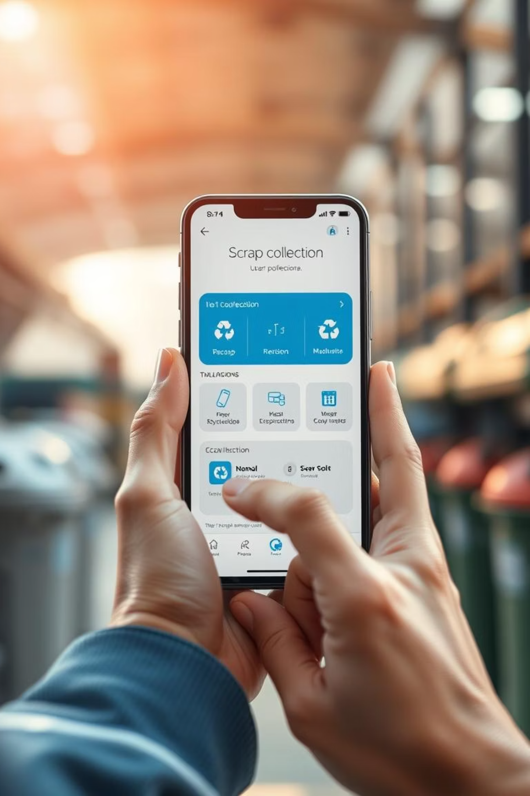
ScrapEasy: Revolutionizing Scrap Collection
A user-friendly mobile application that allows households to easily request scrap pickup services, view live scrap pricing, and receive instant payments. The app also streamlines scrap collection operations for agents, factory teams, and franc

Slide 2
Core Functionality: From Pickup to Payment
1
2
Homepage & Request Form
Agent Module
2
Users access live scrap prices (iron, aluminum, plastic, paper, copper) and initiate pickup requests. The form captures essential details, allowing for scrap type selection, estimated weight input, and optional photo uploads. An auto-calculation feature provides an immediate value estimate.
Field agents log in to view assigned pickups, record actual collected scrap, and auto-calculate payable amounts. Customer verification is secured via digital signature or OTP. Agents can update pickup status, ensuring real-time operational visibility.
4
3
4
Factory Verification
Franchise Module
Backend staff access collected scrap data to cross-check quantities against agent entries. This module facilitates marking items as accepted, rejected, or short, with flagging options for any discrepancies, maintaining data integrity.
Franchises gain access to collection and performance reports specific to their area. This module supports detailed export options (by date, area, agent, material type) for comprehensive analysis and operational oversight.

Slide 3

Actionable Insights: Reports & Analytics
Data is vital for operational efficiency and strategic decision-making. ScrapEasy provides a suite of auto-exportable or downloadable Excel reports, offering detailed insights into collection trends, agent performance, and discrepancy tracking.
Date-wise Collection Summary: Overview of daily or
periodic collection activities.
Agent-wise Collection: Performance metrics for individual
field agents.
Scrap Type-wise Quantity & Value: Detailed breakdown of collected materials and their monetary worth.
Discrepancy Reports: Highlighting inconsistencies between collected and verified quantities.
Franchise Performance Summaries: Comprehensive reports for franchise-specific operational and financial health.

Slide 4
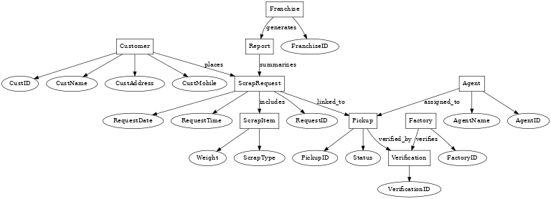
Entity-Relationship Diagram

Slide 5
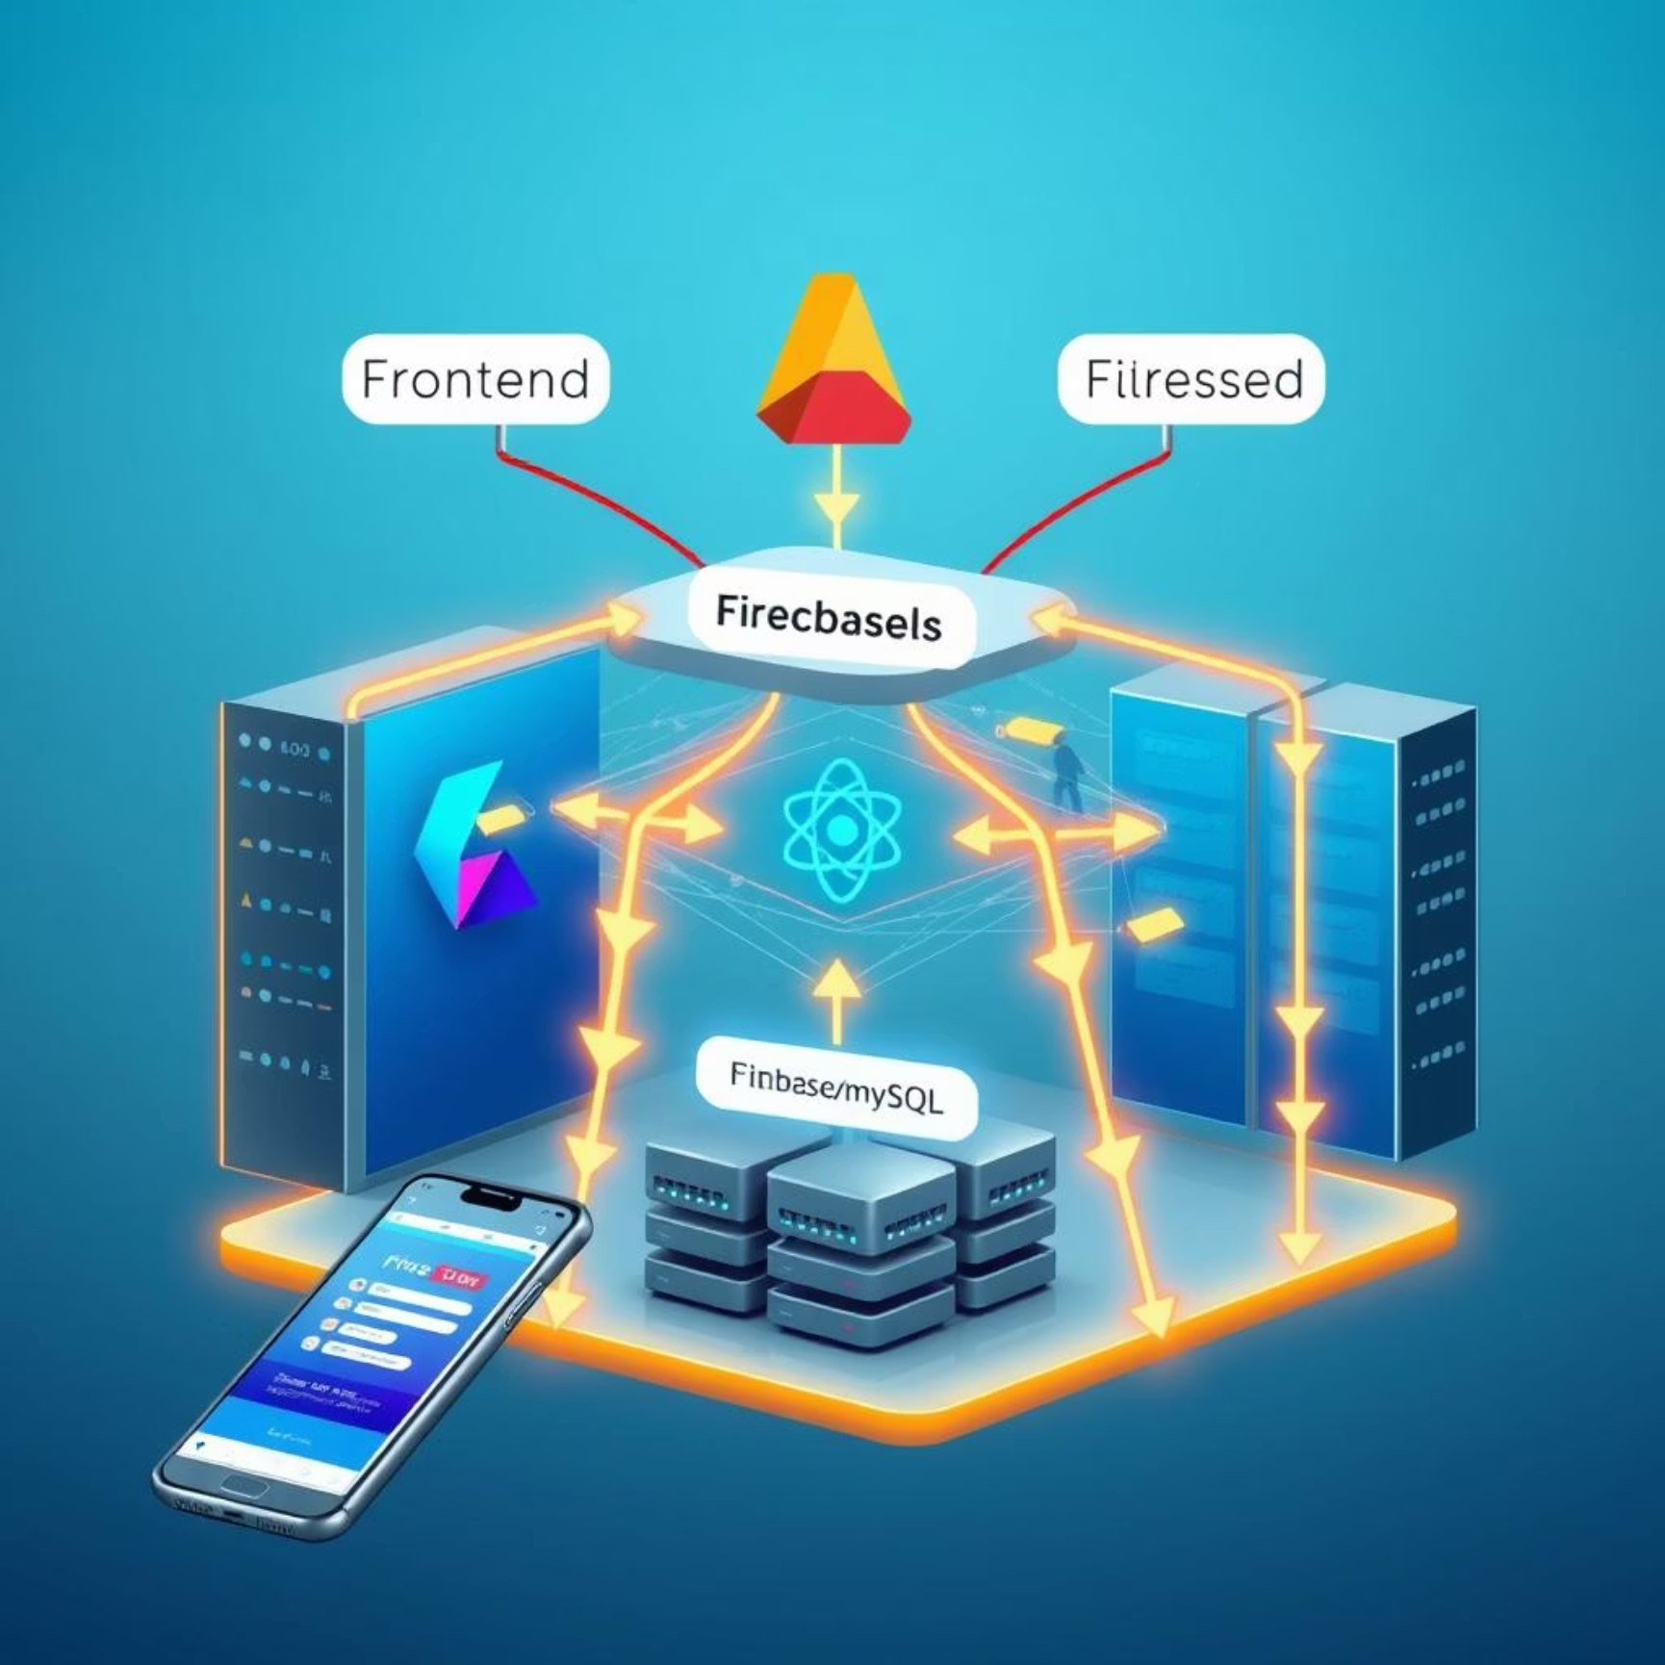
Tech Foundations: Recommended Stack
To build a robust, scalable, and efficient application, we recommend a modern and widely supported technology stack. These choices offer flexibility for students to explore and implement key features effectively.
Frontend
Flutter / React Native: Cross-platform frameworks enabling a single codebase for both Android and potentially iOS (future scope).
Backend
Firebase / Node.js: Firebase offers a comprehensive suite of backend services, while Node.js provides a powerful runtime for custom server-side logic.
Database
Firebase Realtime DB / Firestore / MySQL: Flexible database options catering to real-time updates and structured data storage.
Excel Export
SheetJ S (J S library) / Google Sheets API: Tools for seamless data export to Excel, critical for reporting functionalities.

Slide 6
Thank You

